Slide 1
Year 10 GCSE Scheme of work
Understanding Photography & keywords
Painting shadows

Slide 2
Learning objectives
I will develop an understanding of how to use a camera and all of its settings and features
I will gain knowledge of different types of photographs and techniques used
Gain an appreciation of design software and capabilities in the world of work
I will look at shadows in every day life and use them in my designs and final outcome

Slide 3
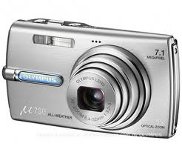
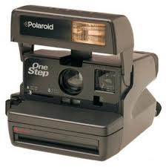
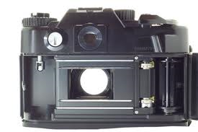
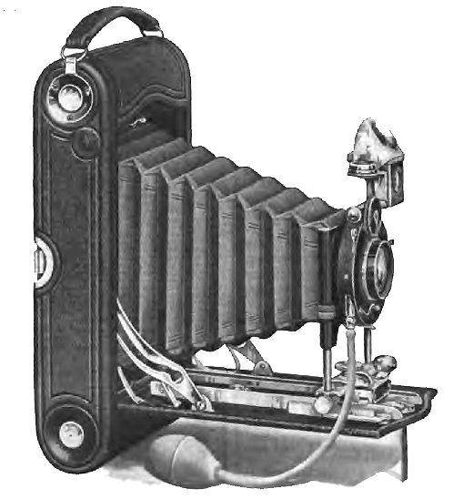
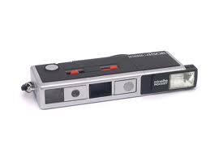
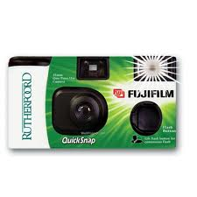
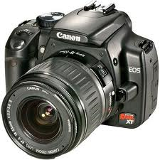
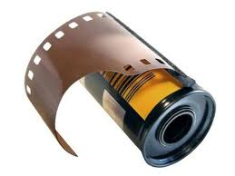
Which objects do
you recognise?

Slide 4
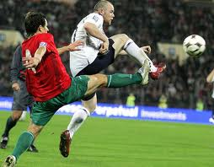
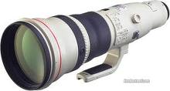
Telephoto lens: opposite of the wide angled lens, it is great for bringing far away objects up close.

Slide 5
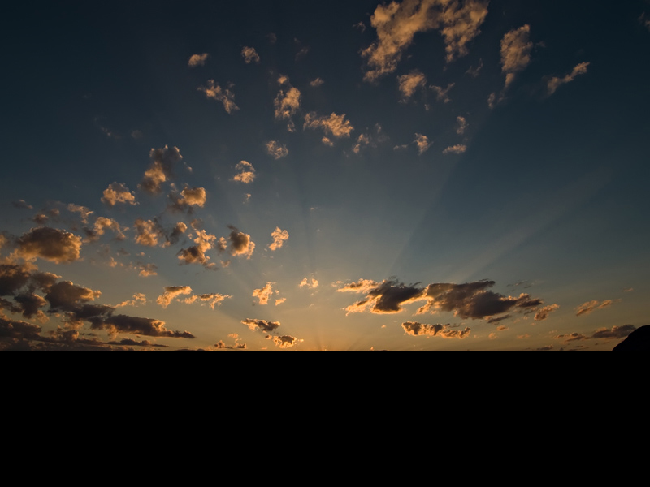
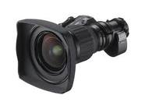
Wide angled lens: Mainly used by landscape photographers, they are great for highlighting foreground objects and fading out the background. This creates depth of an image.

Slide 6
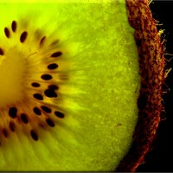
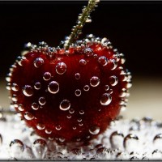
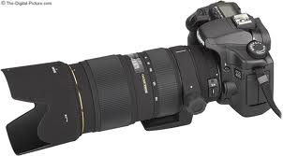
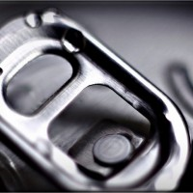
Macro lens: quite simply used for close up photography, focusing a lot closer to the subject.

Slide 7
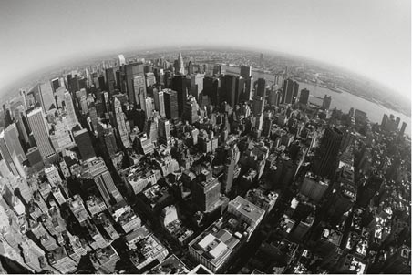
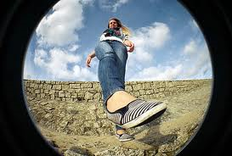
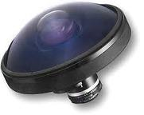
Fish eye lens: middle of the image comes out to meet you, and the top, bottom and sides of the image stay far away.

Slide 8
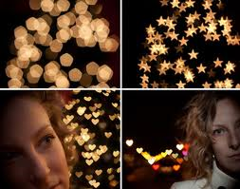
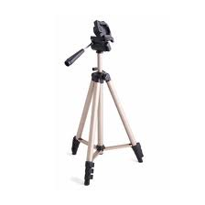
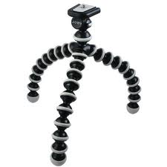
Focus
Out of focus blur – you need to make sure
you use the correct lens setting and hold your camera still.
Camera shake – try to use a tripod or rest your camera on a surface for best results
Gorilla pod
SLR camera tripod

Slide 9
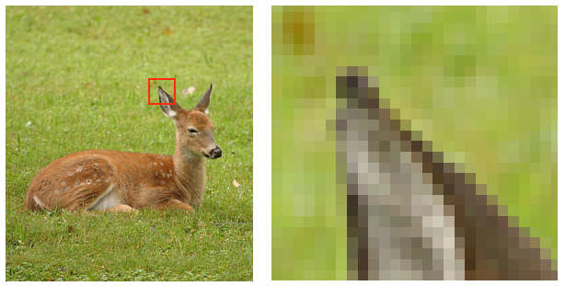
Pixels & Resolution
Pixels - Tiny units of colour that make up digital pictures.
Pixels also measure digital resolution. One million pixels adds up to one mega-pixel.
Resolution - Camera resolution describes the number of pixels used to create the image, which determines the amount of detail a camera can capture. The more pixels a camera has, the more detail it can register and the larger the picture can be printed.

Slide 10
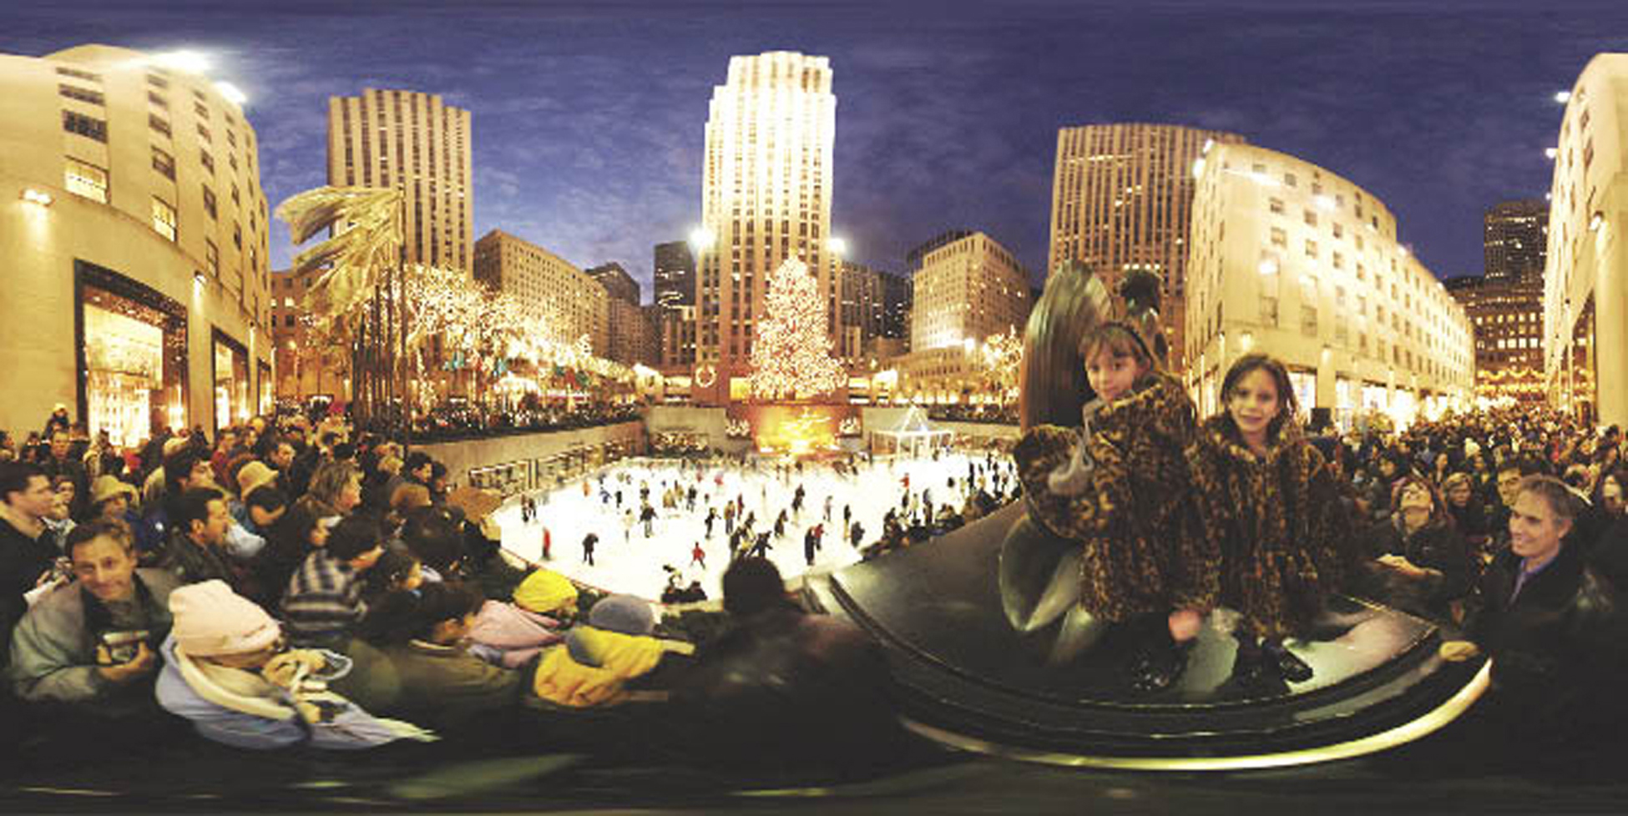
Angles
Angles of images, are important for creativity!
Above......below.....360^{O} .........diagonal........

Slide 11
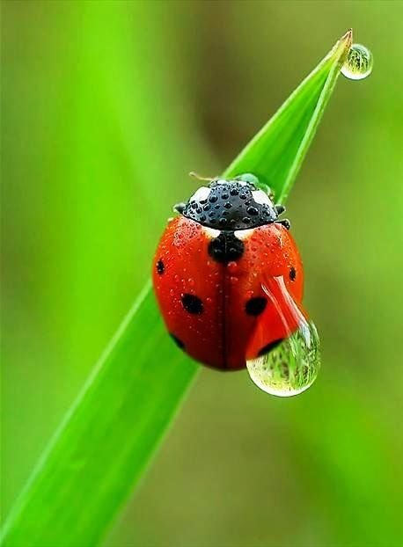
Macro setting
Close up and detailed.
The symbol is a flower on your digital camera, this setting works well on small objects to show maximum detail.

Slide 12
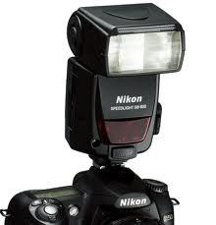
Flash photography
Artificial light
A major purpose of a flash is to illuminate a dark scene
Modern cameras often activate flash automatically
Using on-camera flash will give a very harsh light, which results in a loss of shadows in the image.
Controlling the amount of light in a photograph can affect the image.

Slide 13
Questions keyword definitions

Slide 14
What lens was used to take this picture?

Slide 15
What lens was used to take this picture?

Slide 16
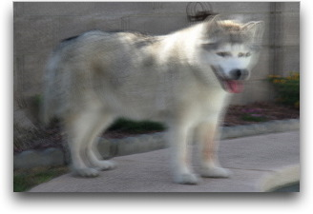
What is wrong with this picture?

Slide 17
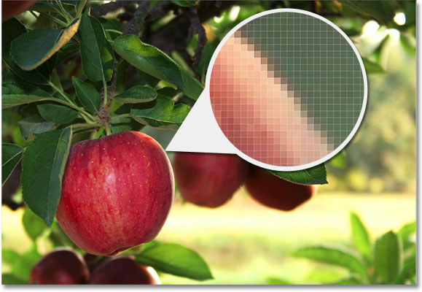
Every image is made up of millions of different coloured squares, So if a picture was taken with a 10 megapixel camera, how many pixels would there be in the picture?

Slide 18
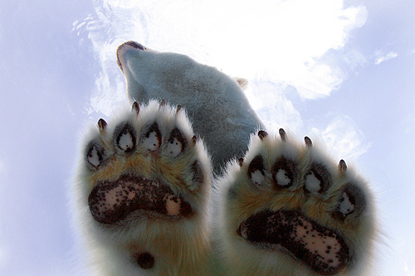
From the aspects of photography we have discussed during the lesson, which aspect has allowed the photographer to capture the underneath of the
polar bear in this image?

Slide 19
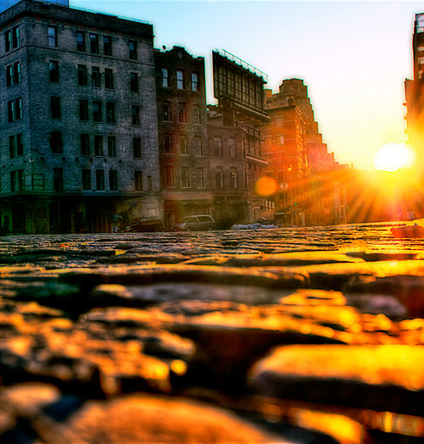
Where was the camera placed to take this photograph?

Slide 20
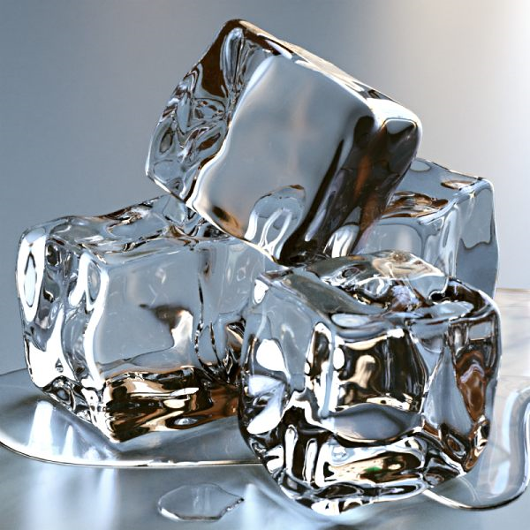
How has the photographer made these ice cubes look
so realistic and not lost any detail or focus?

Slide 21
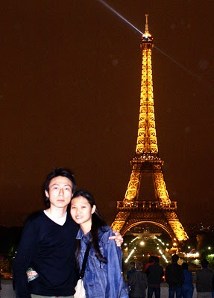
What is the difference between these images?

Slide 22
Keywords
Telephoto lens
Wide angle lens
Macro
Fish eye
Angles
Focus
Camera shake
Flash
Portrait
Landscape
Composition
Proportion
Colour
Sepia
Black and white

