Slide 1
Photoshop Skills
This presentation provides helpful links for your projects
Please remember I usually work from a newer version, but the tools are similar. I have used the internet to try and find the most helpful version of each tool

Slide 2
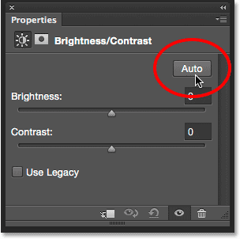
how to adjust brightness/ contrast on photoshop auto is not always better experiment with the sliding bars
https://helpx.adobe.com/photoshop/using/apply-brightness-contrast-adjustment.html

Slide 3
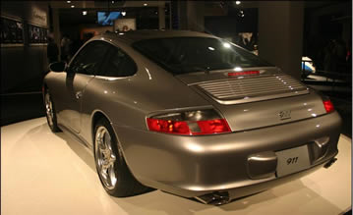
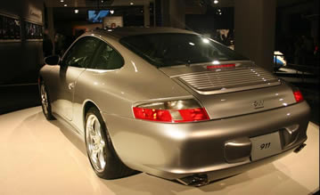
How to spot light
http://photoshopcafe.com/tutorials/Spotlight/spotlight.htm
Before After

Slide 4
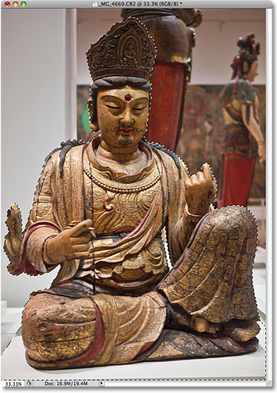
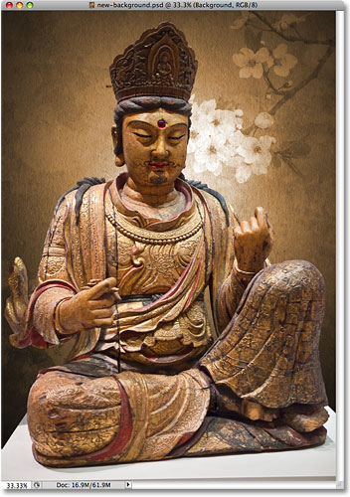
How to use magnetic lasso to copy and paste an image on to a different background
http://www.photoshopessentials.com/basics/selections/magnetic-lasso-tool/
Before After

Slide 5
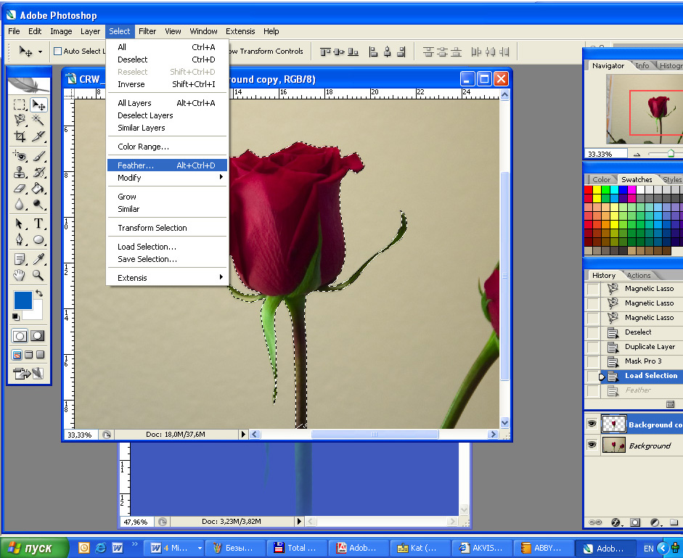
How to soften or feather an edge- good when combining two images together with magnetic lasso
http://geniusdv.com/weblog/archives/soften_the_edges_of_a_layer_using_photoshop_cs.php

Slide 6
how to collage multiple images- you may want to feather here
https://helpx.adobe.com/photoshop/kb/create-collages-montages-photoshop-photoshop.html

Slide 7
How to change the colour of an object
https://blog.udemy.com/change-color-in-photoshop/
Before After

Slide 8
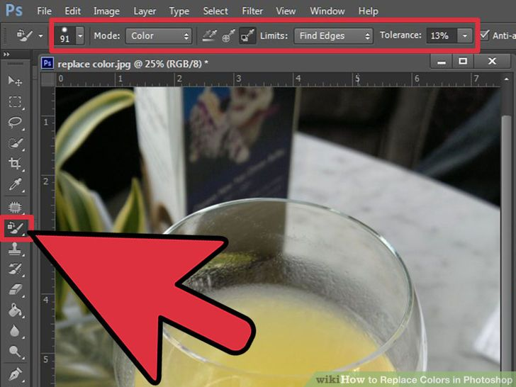
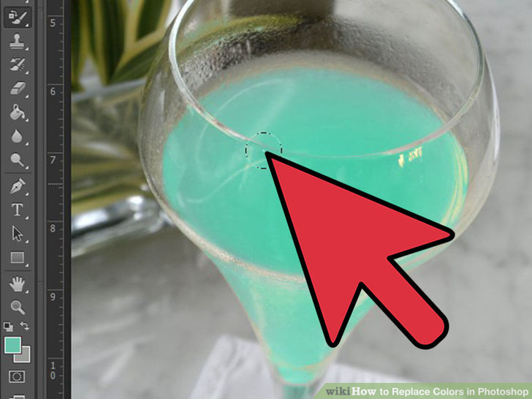
How to change the colour of an object 2
http://www.wikihow.com/Replace-Colors-in-Photoshop
Before After

Slide 9
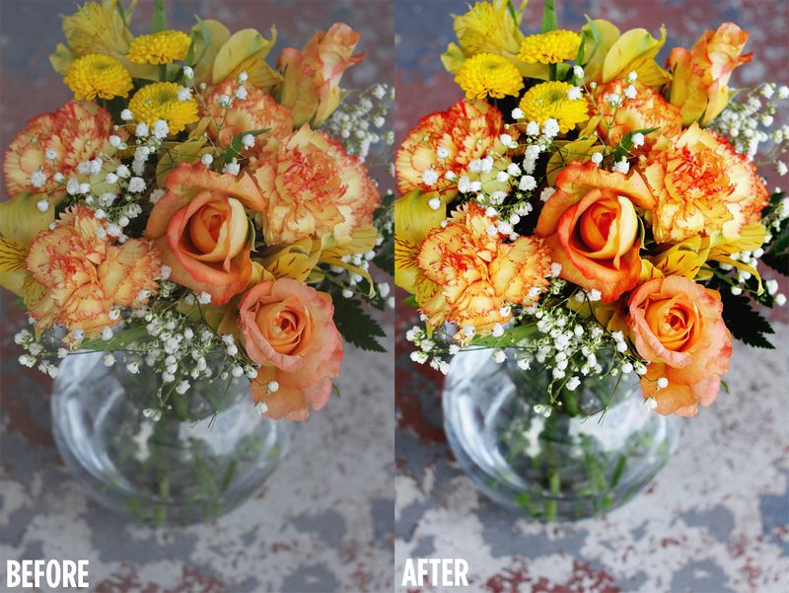
How to change the vibrancy of A whole image
http://www.abeautifulmess.com/2012/07/how-to-create-vibrant-color-photographs.html

Slide 10
A sophisticated Black and white adjustment
https://helpx.adobe.com/photoshop/using/convert-color-image-black-white.html
Video clip worth watching!!
Other ways:
http://blog.spoongraphics.co.uk/articles/the-best-ways-to-make-your-photos-black-white

Slide 11
How to give a blurred dreamlike effect- this is very subtle and if used correctly can show a high level of skill
http://digital-photography-school.com/how-to-create-a-dream-effect-in-photoshop/
Before After

Slide 12
Adding text
From the toolbar, select the Horizontal Type tool or the Vertical Type tool .
Do one of the following:
To create a single line of text, click in the image to set an insertion point for the type.
To create paragraph text, drag a rectangle to create a textbox for the type.
The small line through the I‑beam marks the position of the type baseline. For horizontal type, the baseline marks the line on which the type rests; for vertical type, the baseline marks the center axis of the type characters.
(Optional) Select type options, such as font, style, size, and color, in the tool options bar.
Type the characters you want. If you did not create a textbox, press Enter to create a new line.
The text appears in its own layer. To view the layers, in the Expert mode, press F11.
Commit the text layer by doing one of the following:
Click the Commit button .
Press the Enter key on the numeric keypad.
Click in the image, outside the textbox.
Select a different tool in the toolbox.

Slide 13
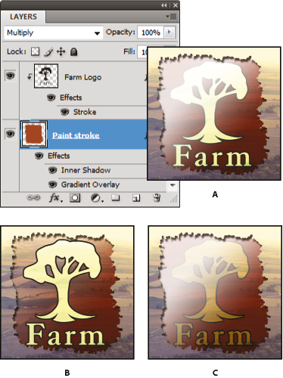
Transparent layering
https://helpx.adobe.com/photoshop/using/layer-opacity-blending.html

